Slide 1
A Case Study in Software Design - 2
Dane Hillard’s “Bark”
CIDM 6330

Slide 2
Extensibility and Flexibility
“What about”
You will invariably start to see things differently and contexts will change
Heraclitus – Life is Flux
Most of better software engineering is poised for this reality
Flexibility via extension
Don’t go back and change the existing thing
Build upon it or at least upon interfaces of understanding

Slide 3
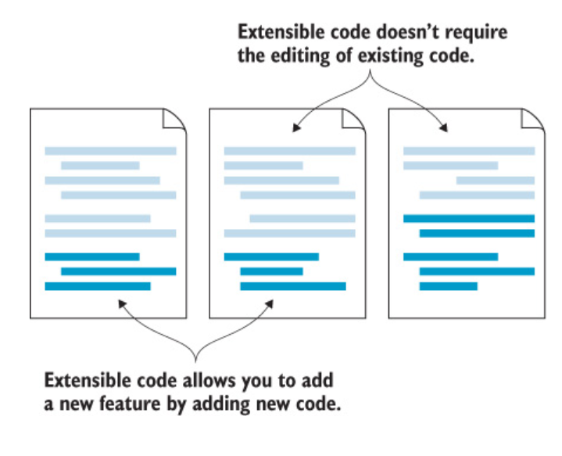
New Behaviors - Extensible

Slide 4
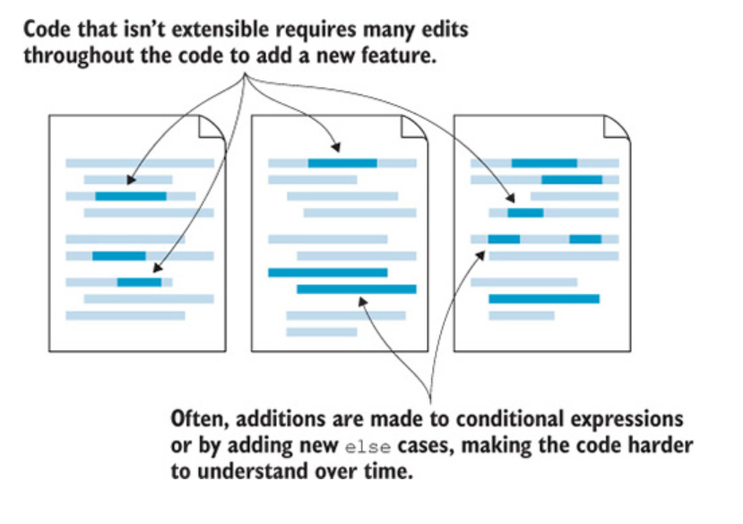
New Behaviors – NOT Extensible

Slide 5
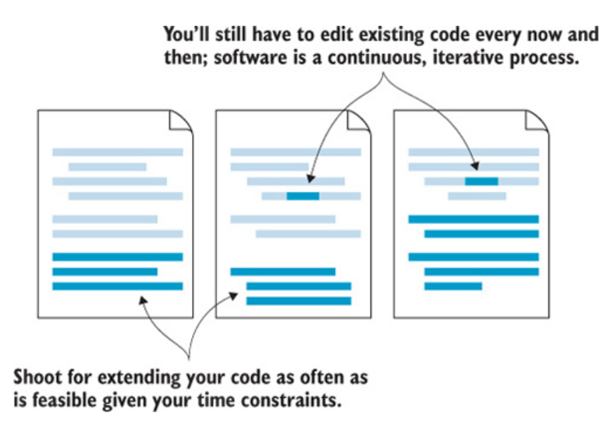
NOT Magic However

Slide 6
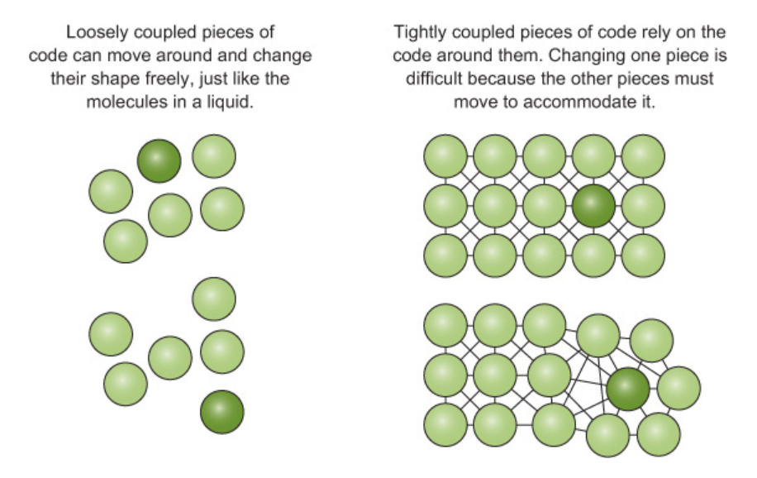
What about Flexibility
Not all changes are extensions
Loose Coupling
Minimize or abstract the effect changes in one module has on the others
Code to contract - Interfaces

Slide 7
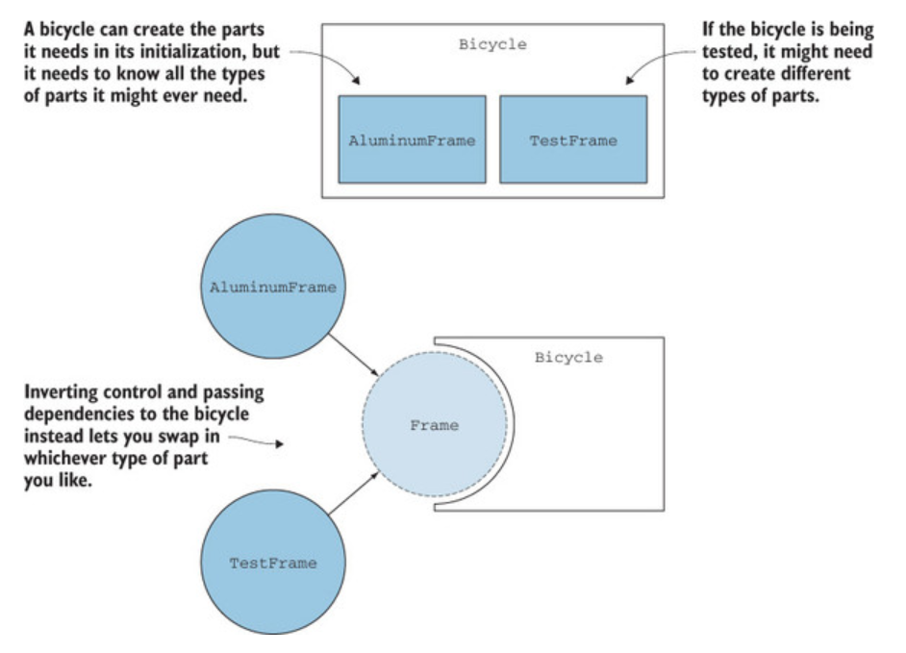
Approaches
Inversion
Of dependency and control
Composition vs Inheritance

Slide 8
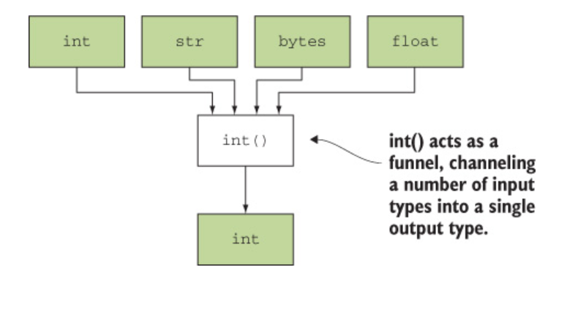
Postel’s Law of Robustness and Entropy
Be liberal in what you accept, and conservative in what you send.

Slide 9
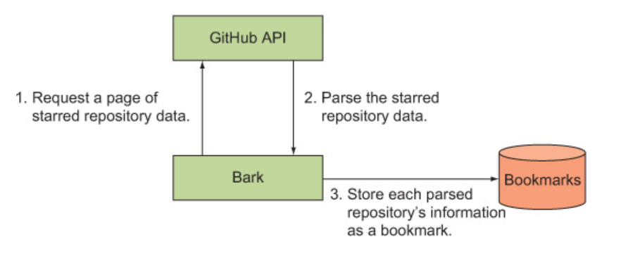
Extension Example
Extend Barky to use an API
GitHub API
Barky

Slide 10
The Code

